Slide 1
AI 510 Artificial Intelligence in Cloud Computing
Module 1
Introduction to AI ON Cloud

Slide 2
LEARNING OBJECTIVES
Understand the meaning of MLOps
Build the concept of MLOps Foundations

Slide 3
What is mlops
Think of MLOps as the process of automating machine learning using DevOps methodologies
+ Automating Data and Modeling
WHY MLOps?
There must not be components of the system that have humans as the levers of the machine
The less manual human processes involved, the less chances making mistakes
What's more, it saves resources and cost with less human involved process

Slide 4
Devops inCludes
Continuous integration (CI)
Continuous delivery (CD)
Microservices
Infrastructure as Code
Monitoring and instrumentation
Effective technical communication
Effective technical project management

Slide 5
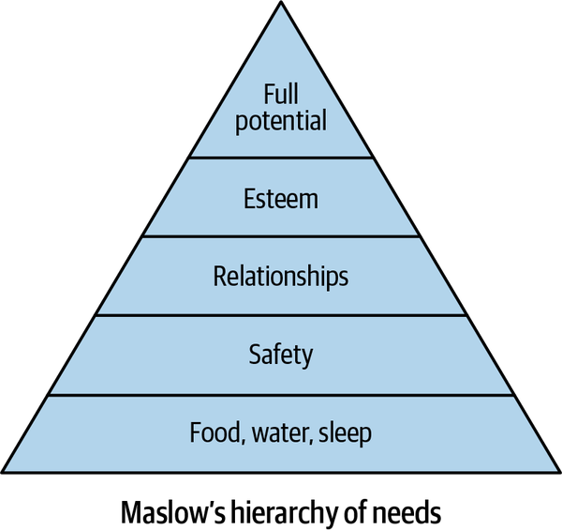
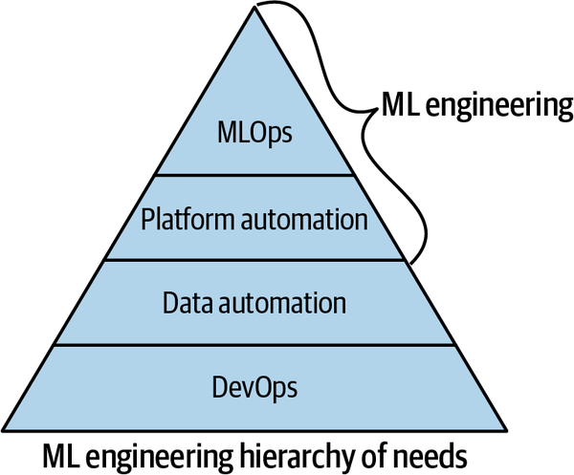
MLOPS hierarchy of needs

Slide 6
Data automation
Periodic collection of data and running of jobs
Processing streaming data
Serverless and event-driven data
Big data jobs
Data and model versioning for ML engineering tasks

Slide 7
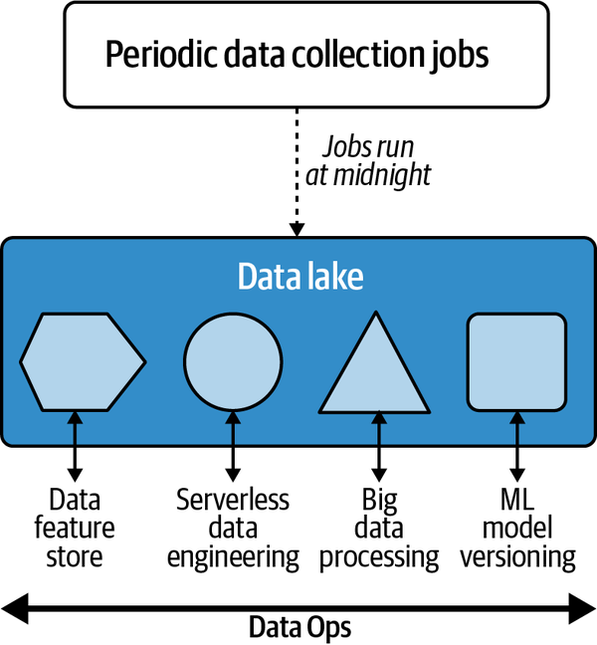
Data engineering with a cloud data lake

Slide 8
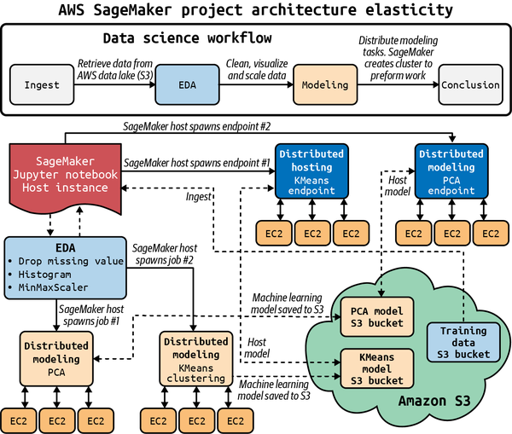
Platform automation An example: Sagemaker MLOps pipeline

Slide 9
MLOPS best Practices
Create reproducible models with robust model packaging, validation, and deployment
Ability to explain and observe model performance

Slide 10
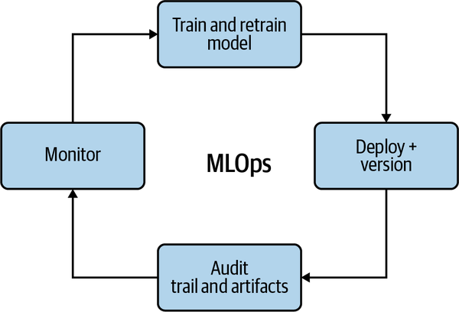
MLOps Feedback Loop

Slide 11
So far
Discussed the importance of using DevOps principles in the context of machine learning
MLOps adds the new complexities of managing both the data and the model
Next going to discuss MLOps foundations

Slide 12
MLOps Foundations
Several key building blocks set the foundation of MLOps
Bash and the linux command line -> cloud shell development environments
Cloud computing environment setup
Python (script) engineering
Machine learning concepts & optimization
Data science

Slide 13
ML Optimization
A fundamental problem in machine learning is the concept of optimization
Optimization is the ability to find the best, or good enough, solution to a problem
Gradient descent is an optimization algorithm at the heart of deep learning

Slide 14
Machine learning key concepts
Machine learning is the ability for computers to perform tasks without explicit programming. They do this by "learning" from data.
Three categories: supervised, unsupervised, and reinforcement learning

Slide 15
conclusion
Went through the foundational knowledge necessary to deploy machine learning into production
Listed critical steps as a company/organization wishing to do MLOps. Such as Linux terminal and how to navigate it, data science engineering and etc.
Also, key concepts of machine learning and deep learning

Slide 16
Reference
Gift, N., & Deza, A. (2021). Practical MLOps: Operationalizing Machine Learning Models (1st ed.). O’Reilly Media.

